Slide 1
DIVERSE TEAMS ARE ESSENTIAL TO QUALITY SOFTWARE
Rebecca Long | @amaya30 PNSQC 2018 | @pnsqc | #pnsqc2018 | #qecamp

Slide 2
OVERVIEW
Introduction
Benefits of Diversity and Diverse Teams
Brief History of Diversity in Technology
Current State of Diversity in Technology
What Can We Do? Ways to Increase Diversity on Your Team(s)
Wrap Up

Slide 3
WHO AM I?
Rebecca Long
Spokane, Washington
Bachelor’s and Master’s in Computer Science
15 years in software engineering focused on quality assurance and DevOps
Lead DevOps Engineer at RiskLens
Founder / President of the non-profit Future Ada
Executive Committee Member of Spokane NOW (National Organization for Women)
Feminist & diversity advocate

Slide 4
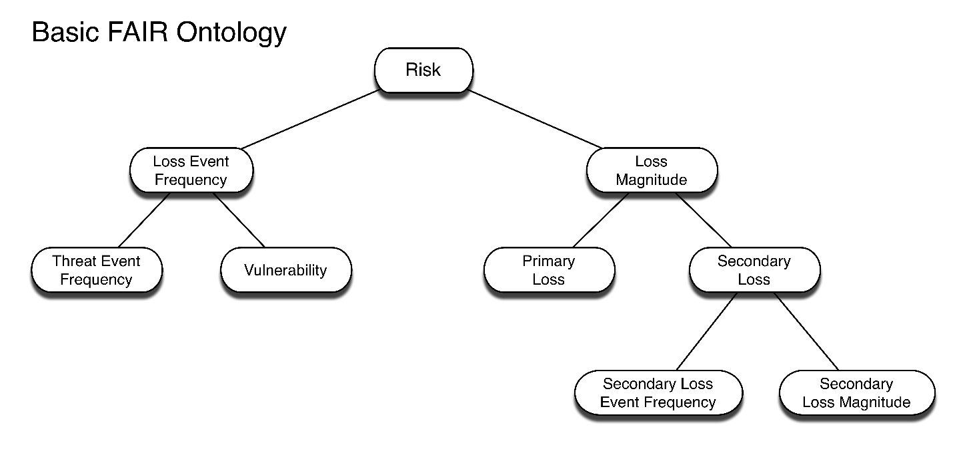
Startup company
Headquartered in Spokane, WA
Build cyber risk quantification and management software based on FAIR (factor analysis of information risk) ontology

Slide 5
FUTURE ADA
501(c)(3) non-profit
Based in Spokane, WA
Named after Ada Lovelace
Advocate for & support women & non-binary individuals in STEAM (science, technology, engineering, art, & mathematics)
Aim for diverse and inclusive STEAM industries

Slide 6
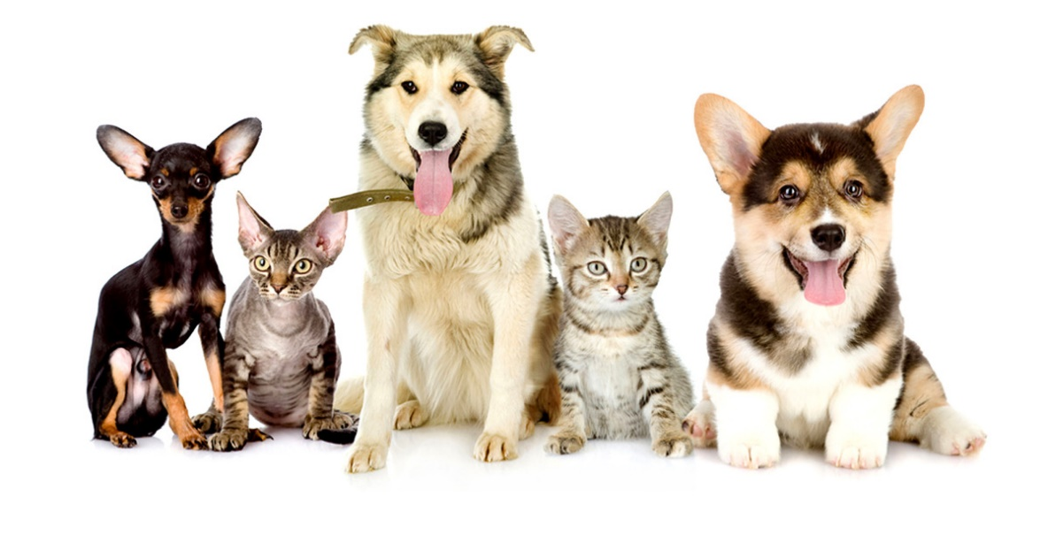
BENEFITS OF DIVERSITY

Slide 9
IF ONLY DUDES ARE DEVELOPING SOFTWARE, THEY ARE SOLVING PROBLEMS ONLY DUDES HAVE.
Sabrina Geremia (@sabrinageremia) of Google

Slide 10
IN THE UNITED STATES, THERE IS A LINEAR RELATIONSHIP BETWEEN RACIAL AND ETHNIC DIVERSITY AND BETTER FINANCIAL PERFORMANCE: FOR EVERY 10 PERCENT INCREASE IN RACIAL AND ETHNIC DIVERSITY ON THE SENIOR-EXECUTIVE TEAM, EARNINGS BEFORE INTEREST AND TAXES (EBIT) RISE 0.8 PERCENT
Jennifer Brown, Inclusion: Diversity, the New Workplace & The Will to Change

Slide 11
BRIEF HISTORY OF DIVERSITY IN TECH

Slide 12
FAMOUS WOMEN FROM TECH HISTORY
Ada Lovelace
Grace Hopper
Katherine Johnson

Slide 14
CURRENT STATE OF DIVERSITY IN TECH

Slide 15
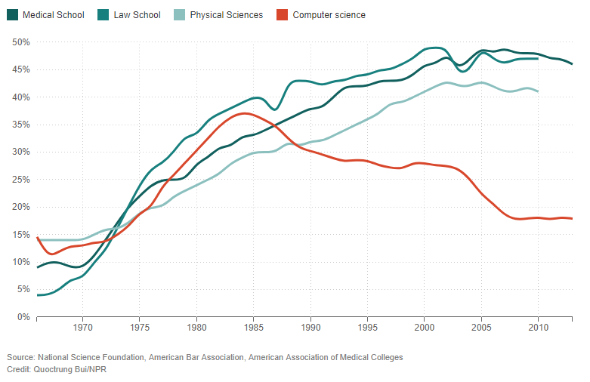
Number of Women In Computer Science Over Time (Henn 2014)

Slide 16
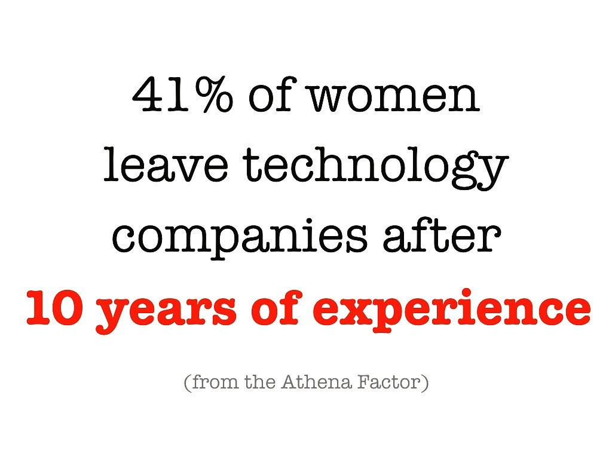

Slide 17
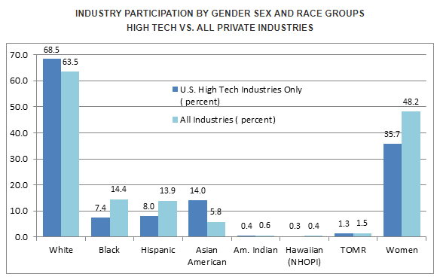
Equal Employment Opportunity Commission stats on race and gender in high tech (EEOC 2014)

Slide 18
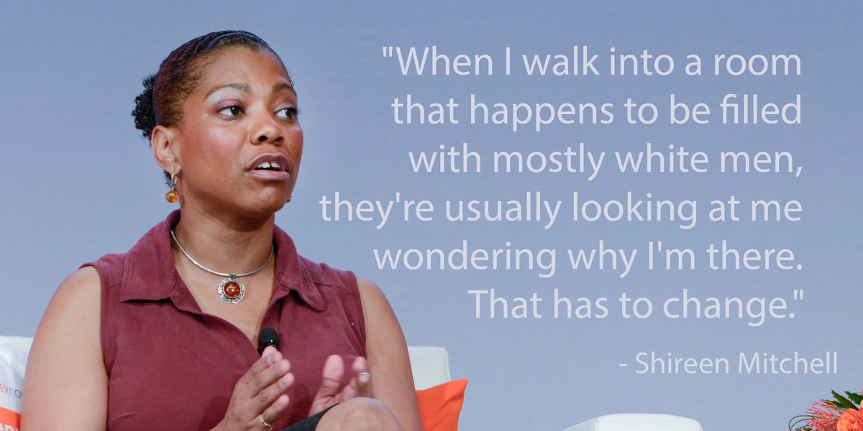

Slide 21
WHAT CAN WE DO?
Let’s work to increase diversity on our software teams!

Slide 22
EDUCATE YOUR TEAM
Educate your leadership and team members on the importance of diversity and inclusion
Develop an annual or semiannual mandatory training on diversity, inclusion, equal employment opportunities
This will help with understanding and reduce the “chances of unfavorable situations” (Forbes Coaches Council 2018)

Slide 23
INCLUSIVE LANGUAGE
Respect the language people call themselves
Recognize different family situations
Avoid negative or demeaning language around people with disabilities
Avoid using statements which perpetuate stereotypes
E.g. “girls aren’t good at math”
Be thoughtful on what imagery you use
Avoid idioms, jargons, and acronyms
If unavoidable, be open to sharing the meaning or providing a definition to help everyone understand
Use gender-neutral terms (hint: “guys” is not one of them)
“language that avoids the use of certain expressions or words that might be considered to exclude particular groups of people, esp gender-specific words, such as "man", "mankind", and masculine pronouns, the use of which might be considered to exclude women”
http://www.dictionary.com/browse/inclusive-language

Slide 24
BE MINDFUL OF UNCONSCIOUS BIAS
We all have them!
Unconscious biases are social stereotypes about certain groups that are formed outside our conscious awareness
Often stemmed from our misconceptions around the belief “that the norms and experiences of our own social group— whether defined by race, class, gender, sexual orientation, disability, religion, or some other qualifier— are, or should be, the same for every other social group” (Jennifer Brown, Inclusion)

Slide 25
EMPATHETIC LEADERSHIP
Remember we are all people with lives, families, hobbies, passions, and emotions
Get to know team members as people
Create a safe space for people to bring their full selves to work
Recognize the emotional impact on employees / coworkers when major life events happen
Births
Deaths
Marriage
Divorce

Slide 26
HIGHER EMOTIONAL QUOTIENTS HAVE GREATER SENSITIVITY AND EMPATHY, ARE RATED AS MORE EFFECTIVE, RECEIVE HIGHER PERFORMANCE RATINGS, DEVELOP HIGH-PERFORMING EFFECTIVE TEAMS, AND CREATE A HEALTHIER … CULTURE
Ari Pinkus, “A Call for More Inclusive, Empathetic Leadership”

Slide 27
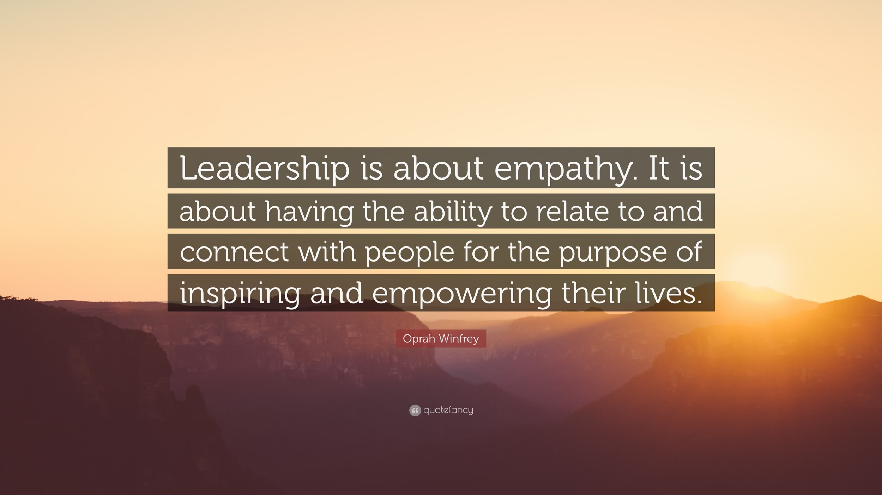

Slide 28
HIRING
Have inclusive language in job postings and avoid problematic phrasing like “rockstar” and “ninja” which women are less likely to identify with
Include a diversity statement on your website and/or job postings
Reach out to underrepresented candidates via networks, community groups, career fairs, and conferences
Have a diverse hiring panel and committee
Standardize position qualifications and interview questions

Slide 29
RETAINMENT
Hold all employees to the same standard for their role
Provide equal opportunities for promotions and raises for women and minority employees
Ensure all employees have growth opportunities
Mentorship programs
Trainings / conferences
Encourage a healthy work/life balance
Offer maternal and paternal leave following a birth or adoption of a child
Offer flexible schedules and remote options
Zero tolerance policies for harassment and safe reporting channels

Slide 30
SUPPORT COMMUNITY ORGANIZATIONS
Women Who Code: https://www.womenwhocode.com
Girls Who Code: https://girlswhocode.com
The Anita Borg Institute: https://anitab.org
Project Include: http://projectinclude.org
Compassionate Coding: https://compassionatecoding.com
<div>ersity: https://hirediversity.us/
Better Allies: https://maleallies.com
Grace Hopper Celebration of Women in Computing: https://ghc.anitab.org
Women in Cybersecurity (WiCyS): https://www.wicys.net/
The Diana Initiative: https://www.dianainitiative.org/
Write/Speak/Code: https://www.writespeakcode.com/

Slide 31
WRAP UP

Slide 32
IT’S ALL ABOUT THE PEOPLE
Creativity + Innovation → Software
Software is built BY people and FOR people
Critically important we have the people building the software represent the people who will be using our software
Diverse team members is the best way to have broad perspectives for creative problem solving and increased innovation
Quality software isn’t just about a low bug count, it’s about building the right product

Slide 33
NEXT STEPS
Simple steps:
Use inclusive language
Be mindful of unconscious bias
Bigger steps:
Foster an inclusive environment
Have strong work policies
Safe reporting methods
Empathetic leadership
All these efforts lead to a stronger, more innovative team which will ultimately produce better software and better bottom-lines
Help create a space where diverse individuals want to be

Slide 34
HELPFUL BOOKS
Inclusion: Diversity, The New Workplace & The Will To Change by Jennifer Brown
The New Alpha: Join the Rising Movement of Influencers and Changemakers Who are Redefining Leadership by Danielle Harlan

Slide 35
HELPFUL RESOURCES
“The 3 Research-Backed Benefits of Diversity That Guide Our Team Growth.” https://open.buffer.com/diversity-benefits/
“An Incomplete Guide to Inclusive Language for Startups and Tech.” https://open.buffer.com/inclusive-language-tech/
“HOWTO recruit and retain women in tech workplaces.” http://geekfeminism.wikia.com/wiki/HOWTO_recruit_and_retain_women_in_tech_workplaces
Harvard Business Review: “How Diversity Can Drive Innovation.” https://hbr.org/2013/12/how-diversity-can-drive-innovation
Forbes Coaches Council: “13 Effective Ways to Educate Employees on Diversity.” https://www.forbes.com/sites/forbescoachescouncil/2018/06/28/13-effective-ways-your-organization-can-educate-employees-on-diversity/#4624a51756ab
“A Call for More Inclusive, Empathetic Leadership.” https://www.nais.org/learn/independent-ideas/november-2016/a-call-for-more-inclusive,-empathetic-leadership/

Slide 36
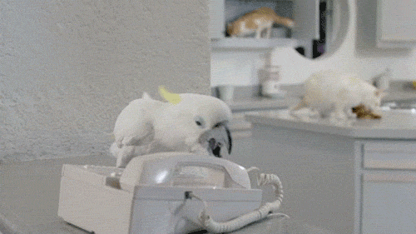
LET’S CONNECT!
Rebecca Long
Future Ada
rebecca@futureada.org
http://rebeccalong.tech
Social: @amaya30
hello@futureada.org
http://futureada.org
Social: @futureada
Blog: https://medium.com/future-ada
RiskLens
rlong@risklens.com
http://risklens.com
Twitter: @risklens

Slide 37
THANK YOU!

